Slide 1
Fundamental Big Data Analysis & Science
Data Science

Slide 2
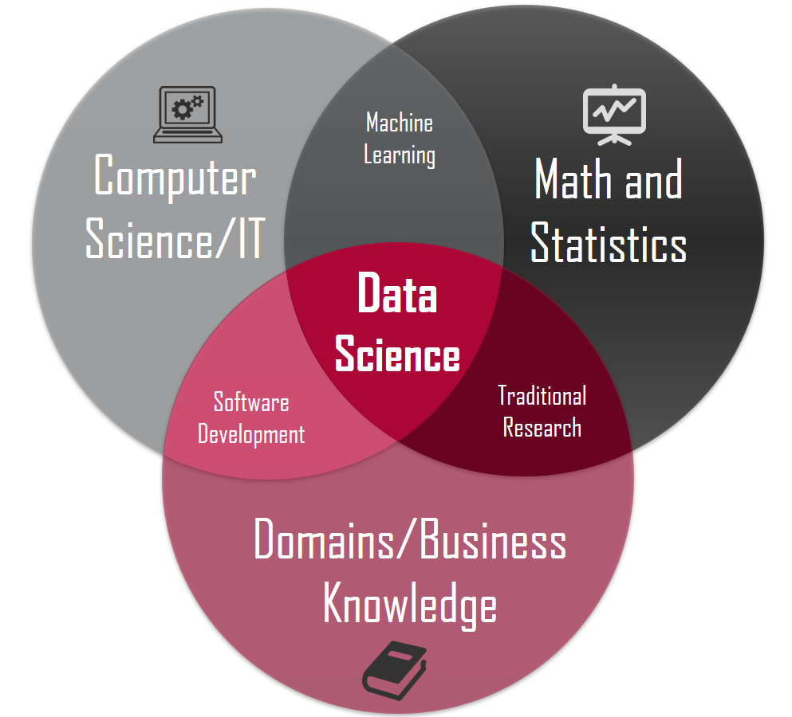
What is Data Science?

Slide 3
How to handle data
A possible data workflow
Get a feel for the data
Plot
Describe
Dance with it
Figure out what problem you want to solve
Clean it!
Missing values? Fix them!
Nonsensical columns? Deal with them!

Slide 4
How to handle data
Generate your model
Try different classification models
Cross validate it on training sets
Test the performance by validating on a test set

